Slide 1
HAE DAY in MACEDONIA ☺ 2018
by Natasha

Slide 2
HAE Macedonia organized a creative workshop for the youngest ones, in the anticipation of HAE day.
We felt that children should be taught compassion and empathy from the earliest days. It can best be taught if they “experience” how their friends with HAE feel first hand. By using dough, they were trying to draw, write and play with ball to try and get what it feels like to do all that with a swelling on their hand.

Slide 3
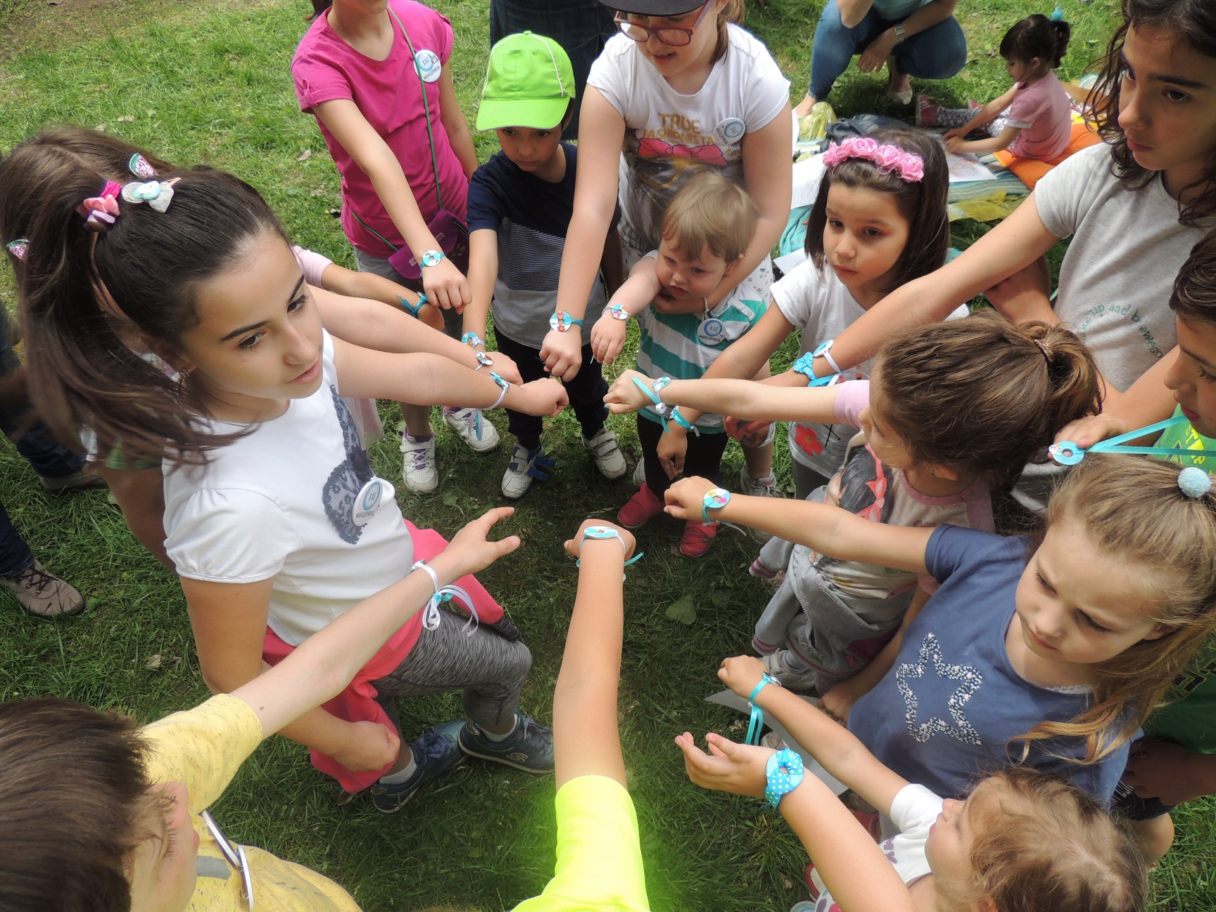

Slide 4
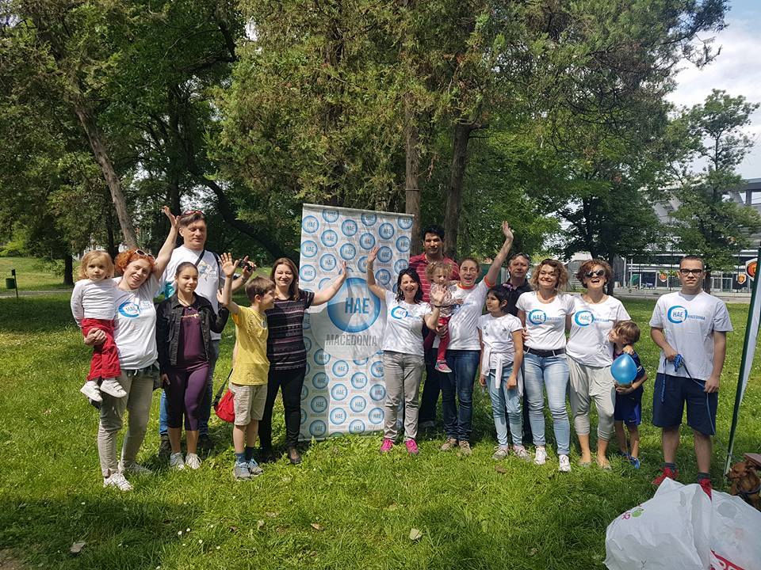

Slide 5
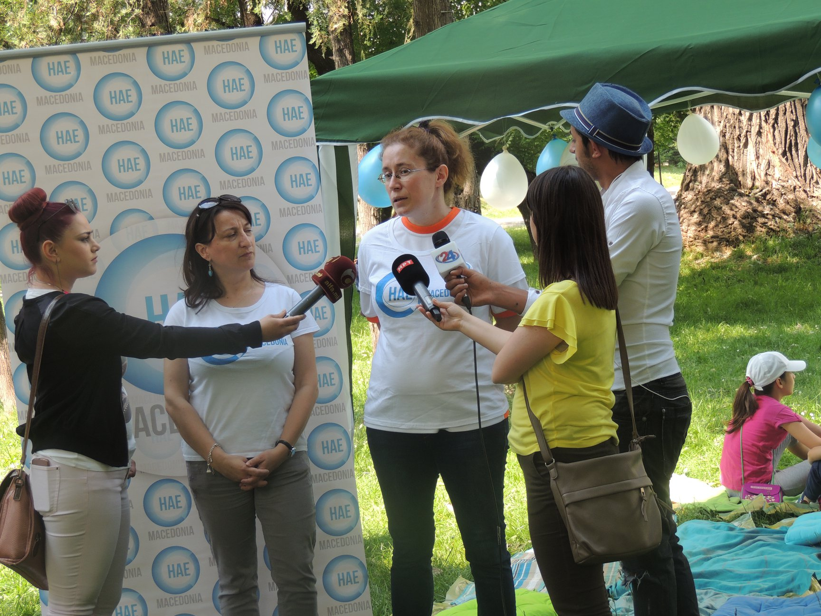

Slide 6
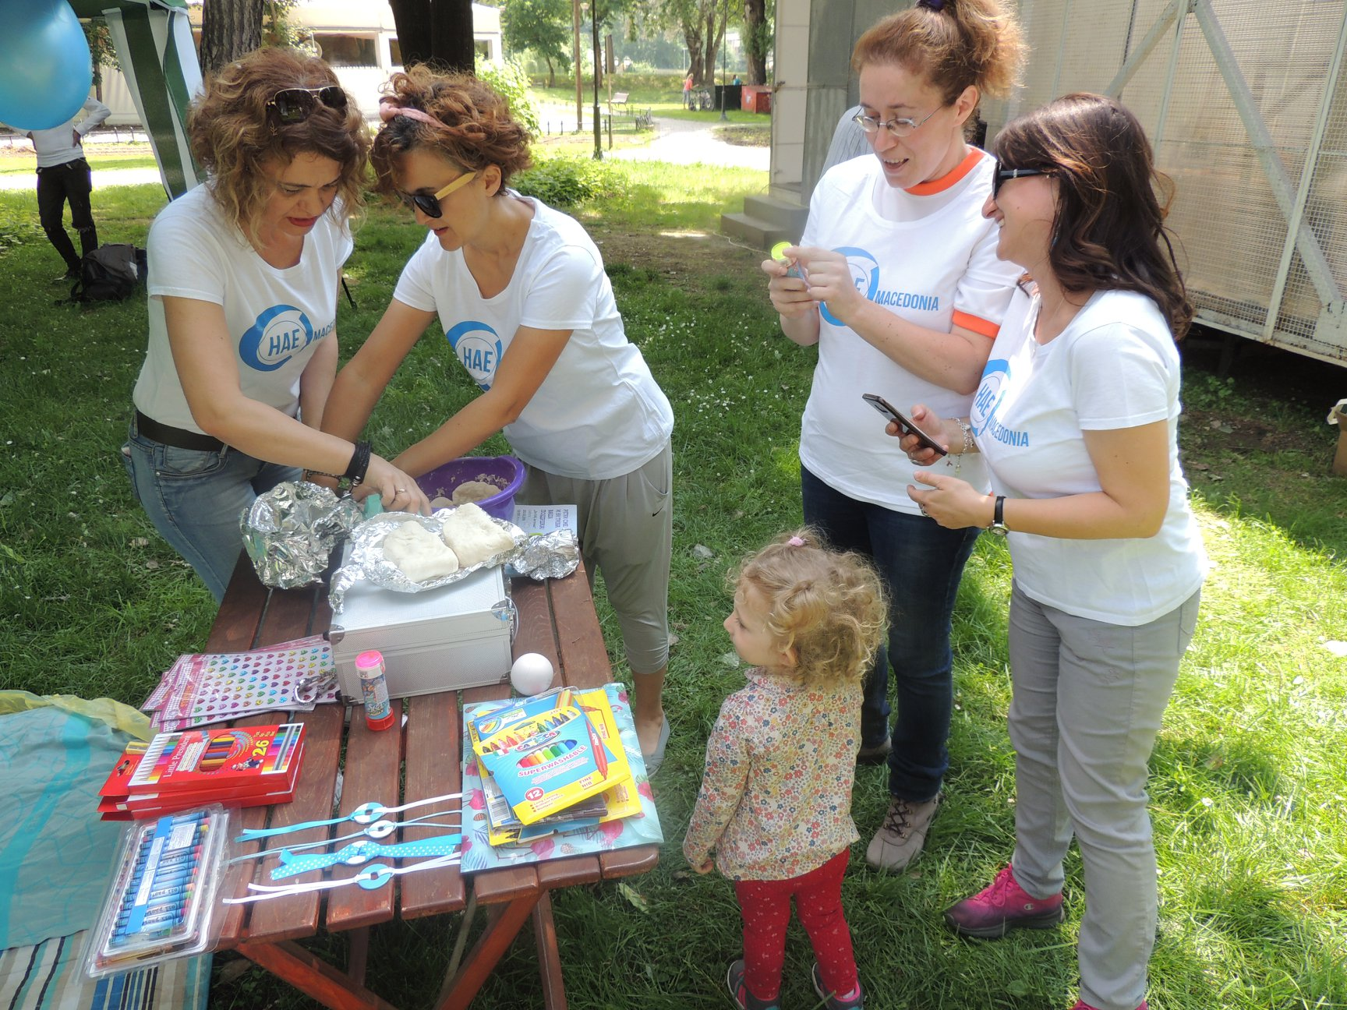

Slide 7
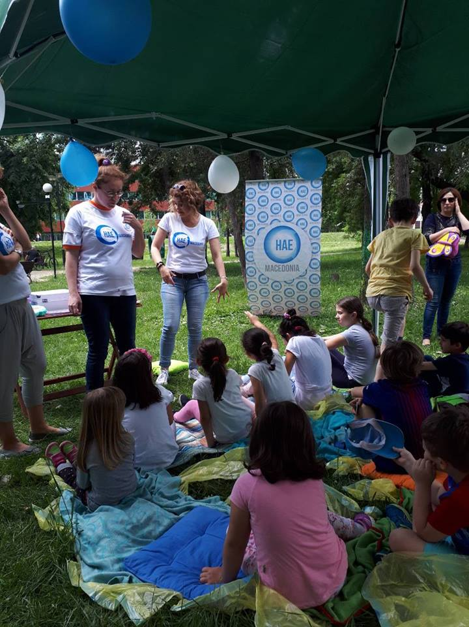

Slide 8
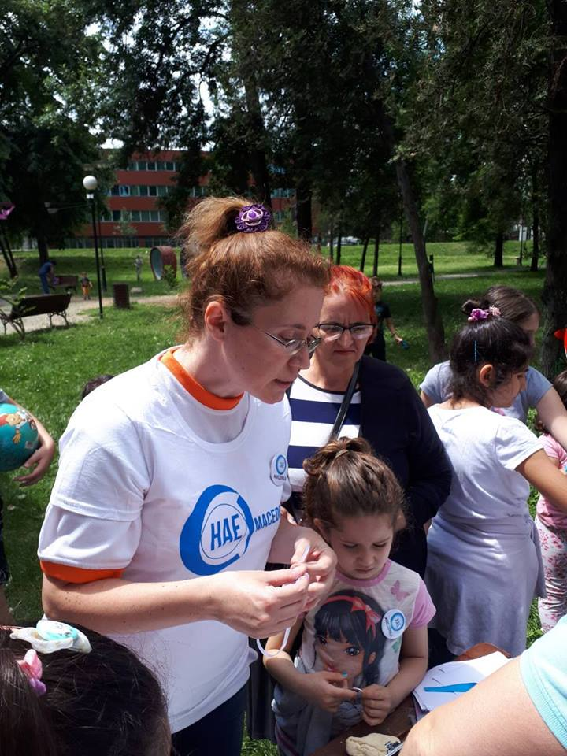

Slide 9
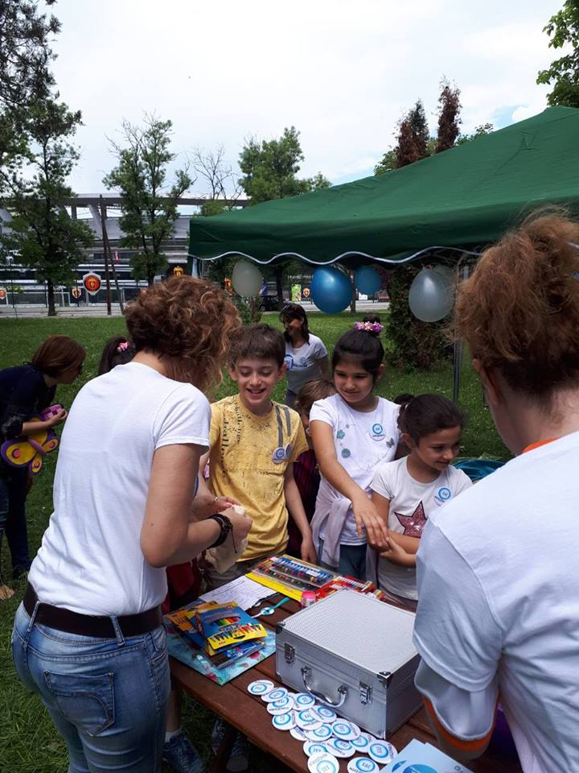

Slide 10
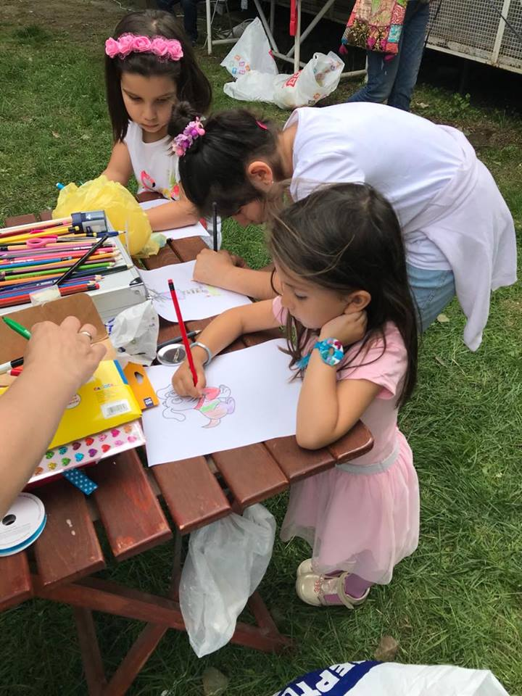

Slide 11
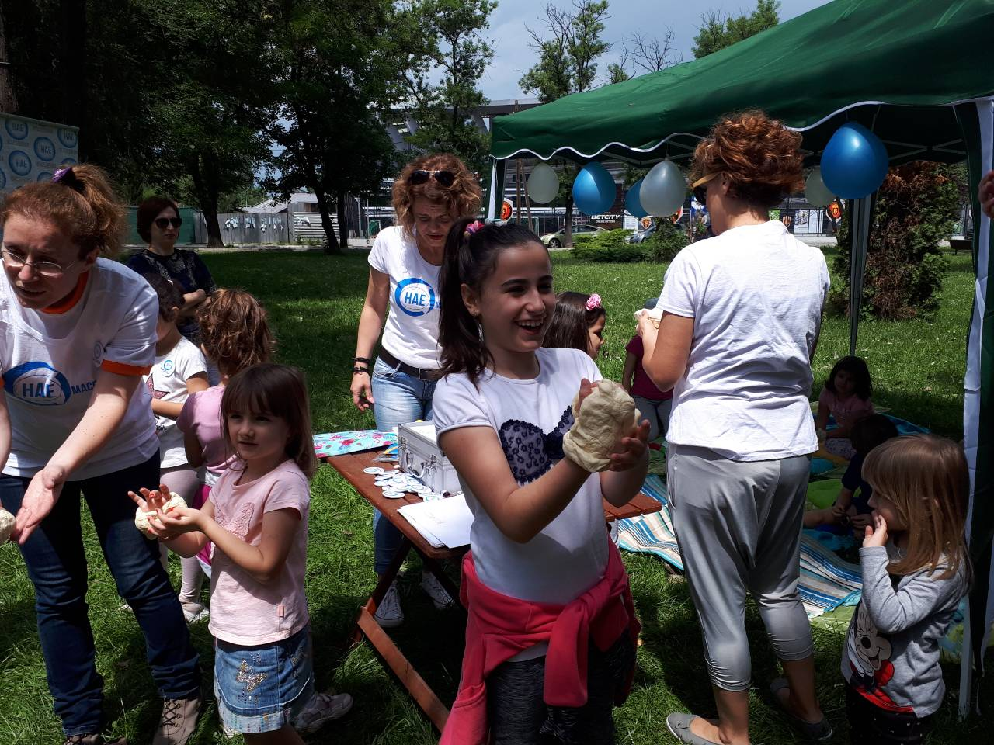

Slide 12
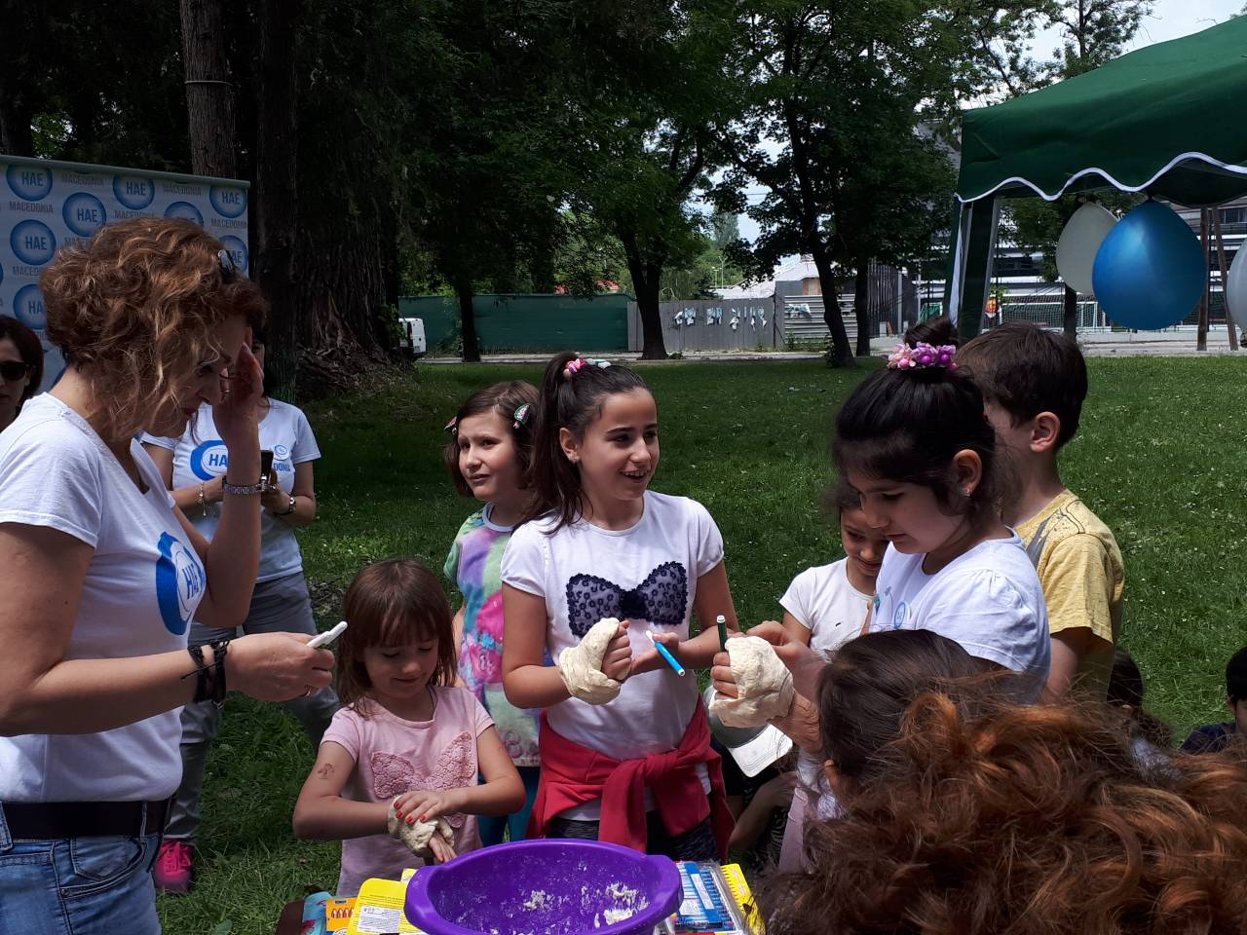

Slide 13
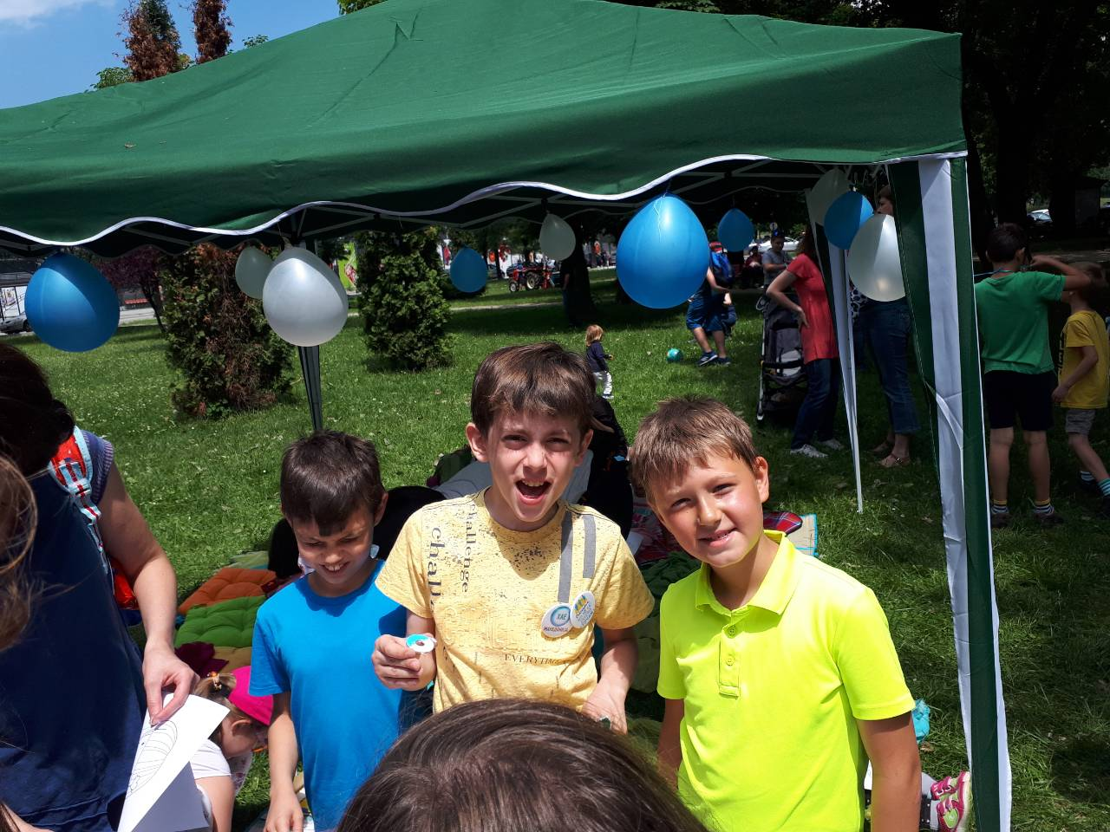

Slide 14
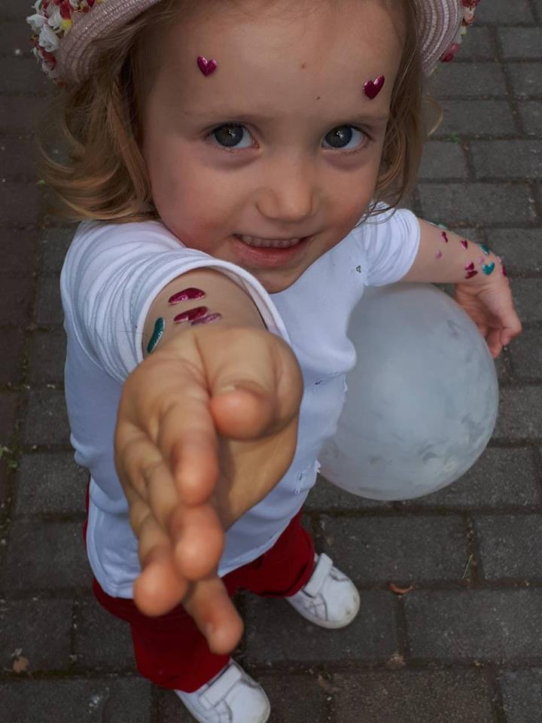

Slide 15
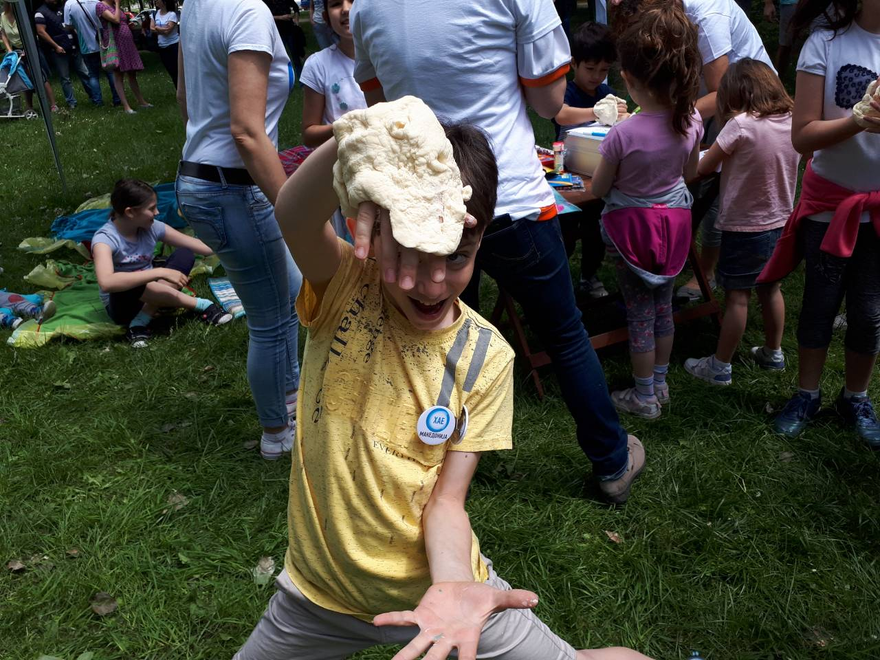

Slide 16
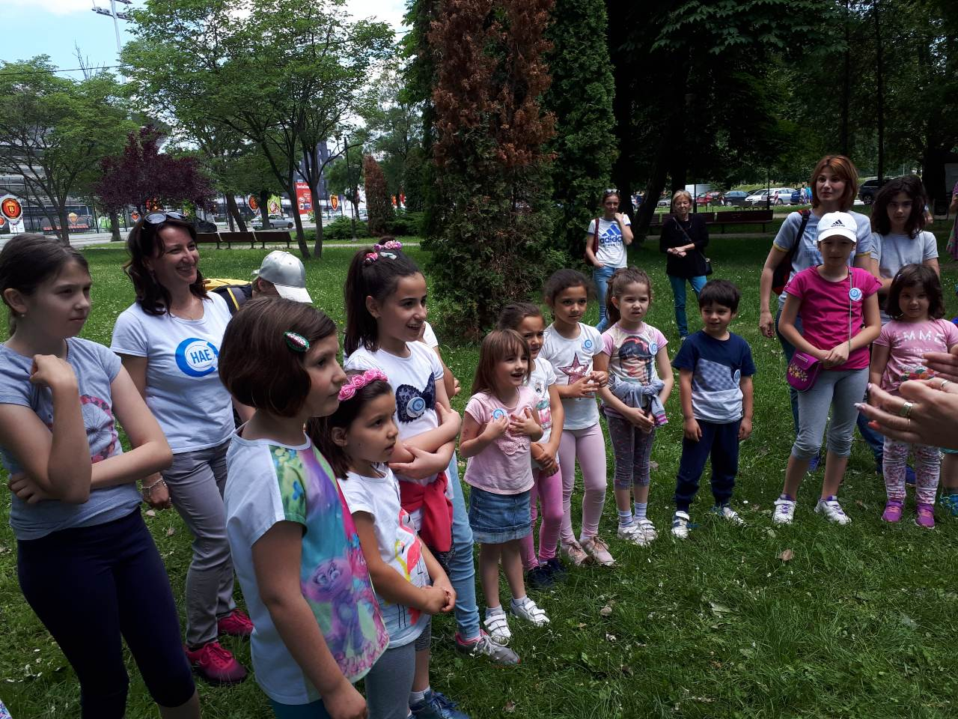

Slide 17
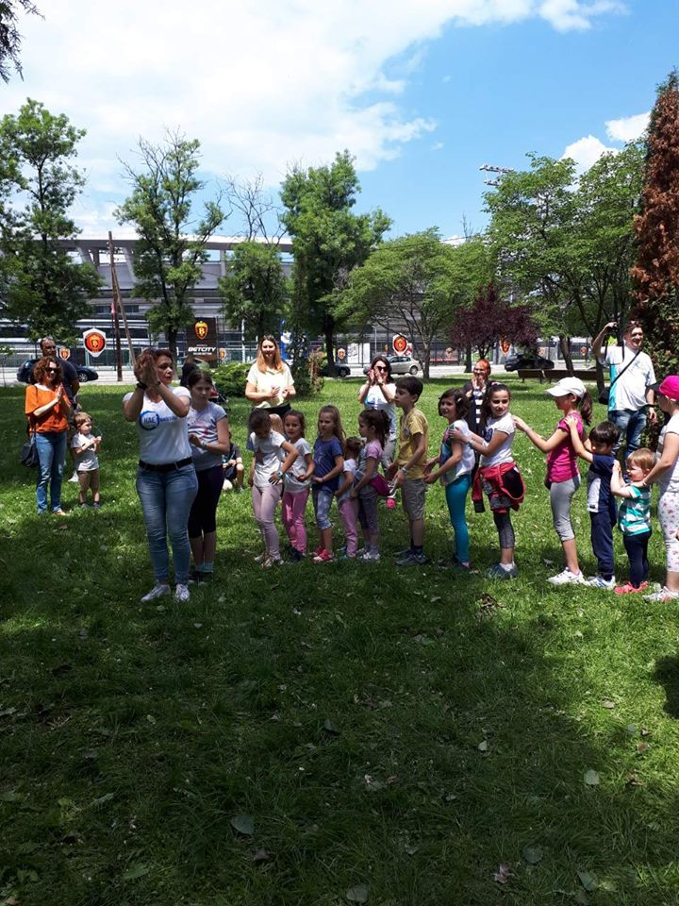

Slide 18
Children learned to rap a song about HAE, drew a swollen part to the body of their favorite animal or a super hero and learned to share something nice by making a friendship bracelet and giving it to their friend, while receiving a friendship bracelet in return.

Slide 19
ХАЕ РАПЧЕ
ХАЕ тоа болест е Дење, ноќе не спие Раче, ноџе, стомаче Се може да отече.
Кажи сега докторе Како да се лечиме? Апче, лекче, чекај СТОЈ! Па јас сум ХАЕ херој!
приватно училиште за странски јазици ЛИОН

